Slide 1
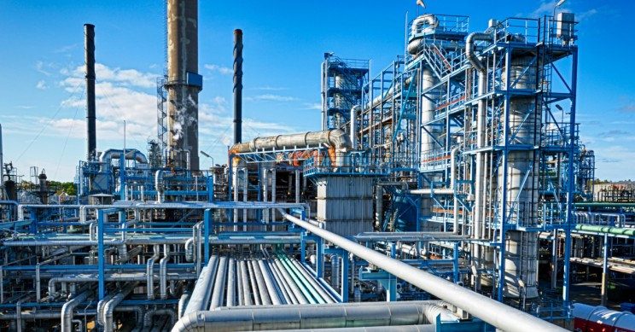
Improving the performance of seismic fault detection using Convolutional Neural Network
Team Members
Himanshu Badera
Abhishek Goyal
Danilo Meza
Praveen Dasari
Subhash Mekapati
Nikhil Gorantla

Slide 2
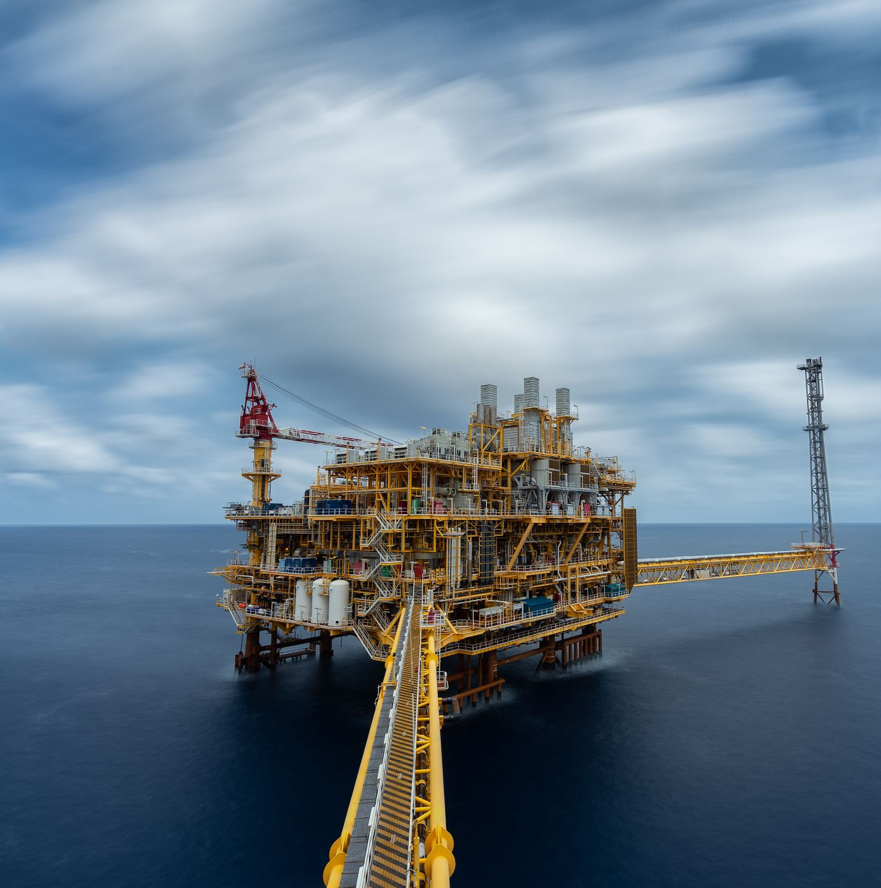
Introduction
Seismic surveys are one of the primary mechanisms used in oil and natural gas exploration, both onshore and offshore.
It can be divided in two major steps: Data Acquisition and Seismic Interpretation

Slide 3
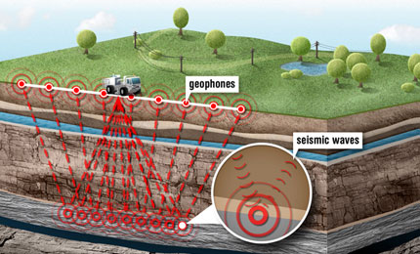
Data Acquisition
An energy source is used to send a wave into the subsurface.
Wave interactions occurs at rock layers, and they can reflect, refract, or diffract in different ways.
Geophones record the travel time of the wave.

Slide 4
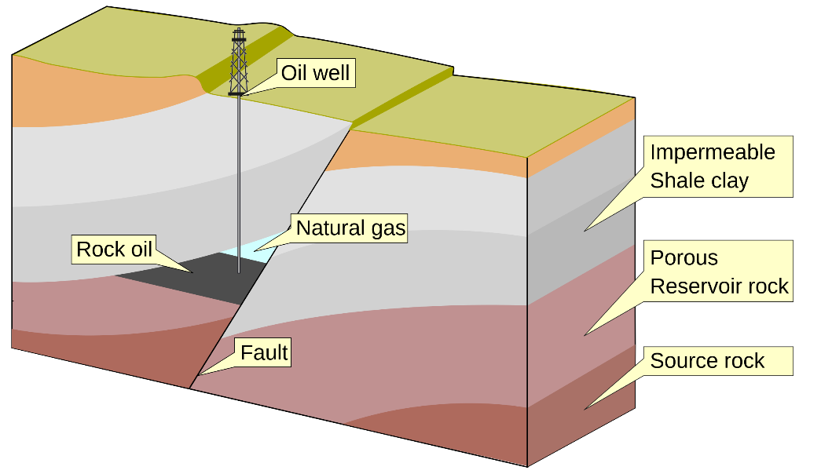
Seismic interpretation
After processing this data, a seismic interpreter will then have the task of mapping geological faults.
Faults are geological structures created by the combination of many processes.
Faults are important for oil and gas exploration because they may act as a natural trap for hydrocarbons and can also help in the migration of these.
The quality of the reservoir characterization process is related to the accuracy of the geological mapping.

Slide 5
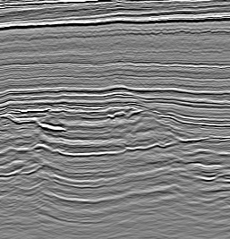
Fault Detection
Traditional methods require tracing and labeling faults manually. This process is inefficient as it could take anywhere from weeks to months to label faults in a typically sized dataset.
Statistical models can be tried, but their use is limited and not very effective.
The best detection mechanisms use machine learning and deep neural networks (DNNs) to achieve fast and reliable results in fault detection.
The convolutional neural network (CNN) is one of the most common DNNs, and it has proven to be very effective at many tasks.

Slide 6
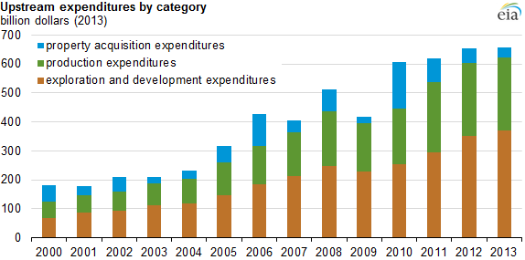
Business Problem
Costs of exploration and drilling make up a large portion of the yearly expenditures of an oil producer, so cost-saving strategies are of high importance.
The possible economic potential benefits of our model are:
Significant reduction of labor and time.
Reduction of dry holes.
Large datasets not needed.
Faster exploration cycles.

Slide 7
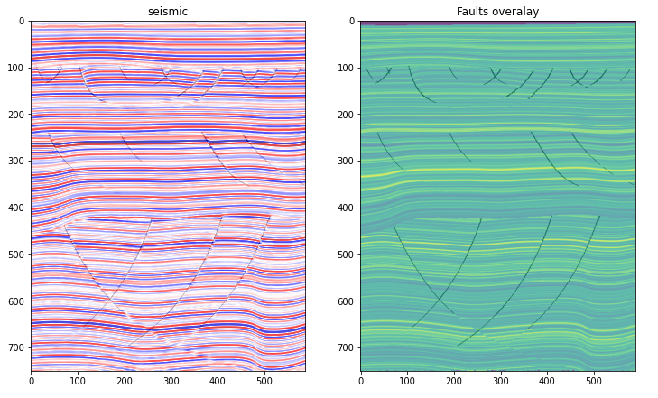
Datasets
The synthetic data were taken from FORCE competition provided by XEEK.ai. To get more information, follow the link at XEEK.ai
An example of a seismic images with fault overlay:
There are 101 in lines, 589 crosslines, and 751 samples in total.

Slide 8
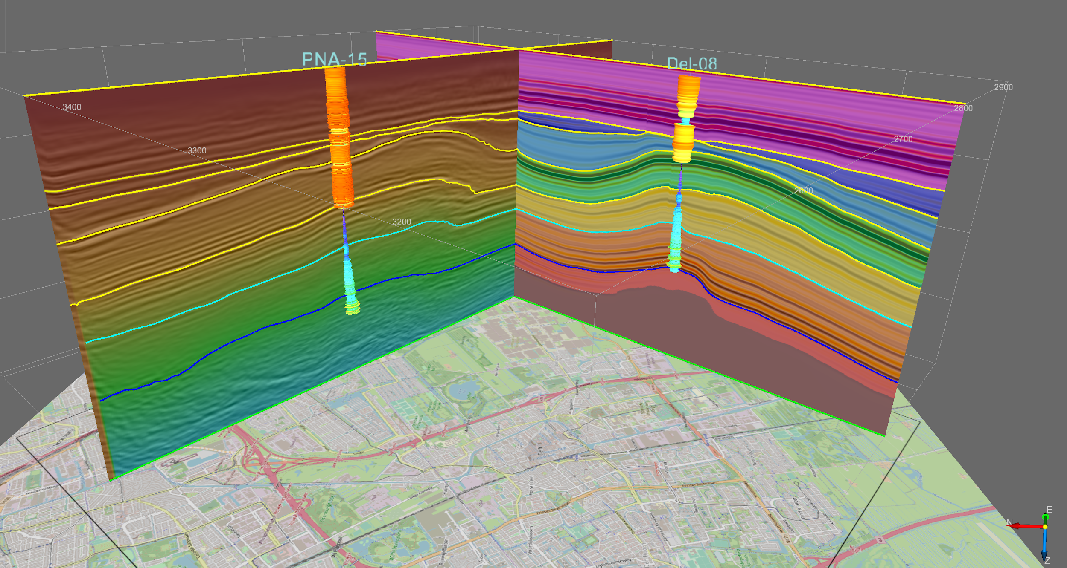
Methodology
Used CNN U-Net Architecture
Encoder-decoder
Semantic Segmentation
Optimizer: Adam
Learning rate: 0.0002

Slide 9
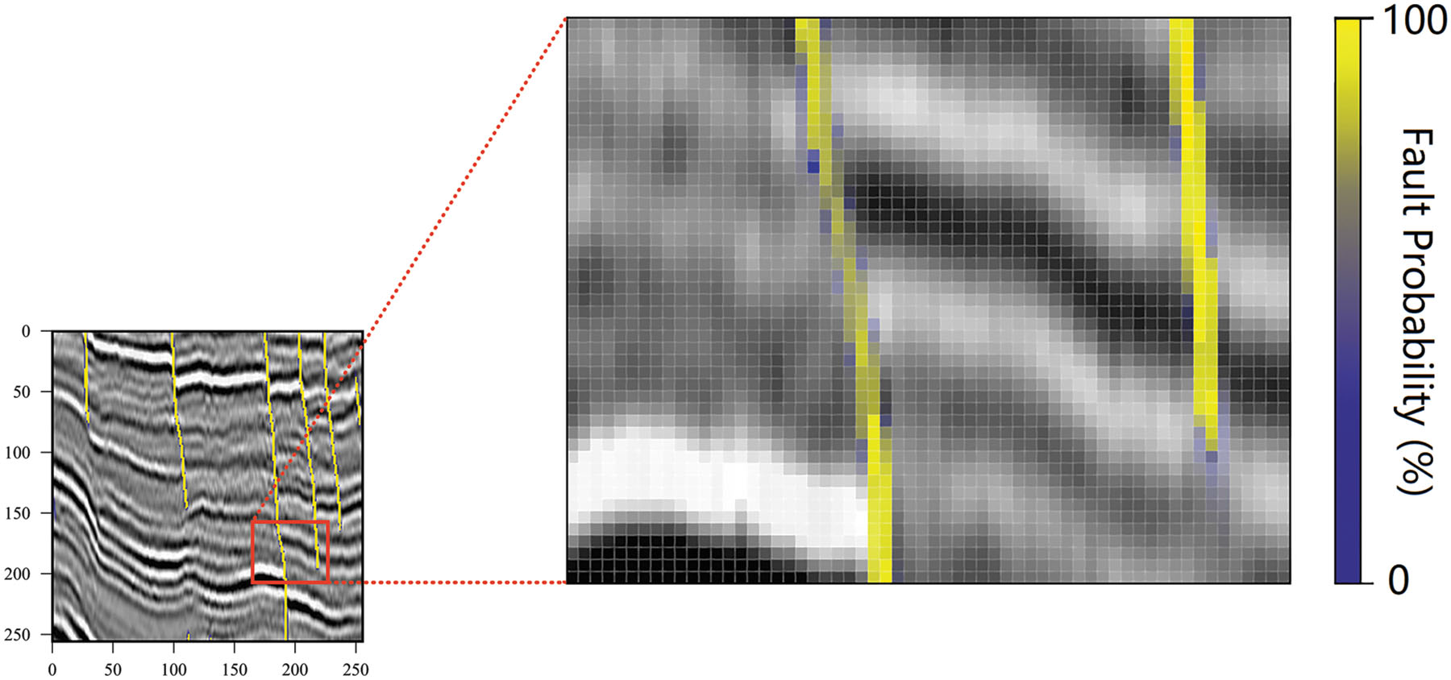

WHY SEMANTIC SEGMENTATION?
Large amount of manually labeled real data is usually beyond reach.
One-hot vector
Cell segmentation and satellite image segmentation

Slide 10
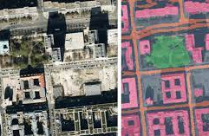
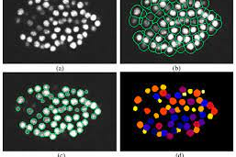

SATELITE IMAGE SEMANTIC SEGMENTATION
CELL IMAGE SEMANTIC SEGMENTATION

Slide 11
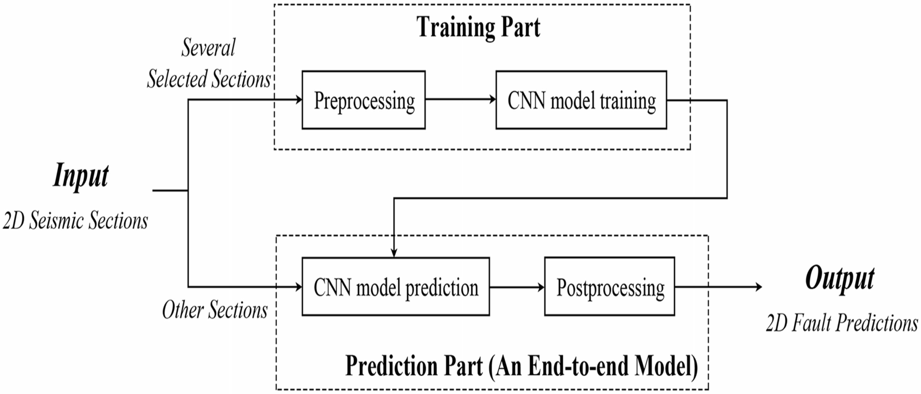
WORKFLOW

Slide 12
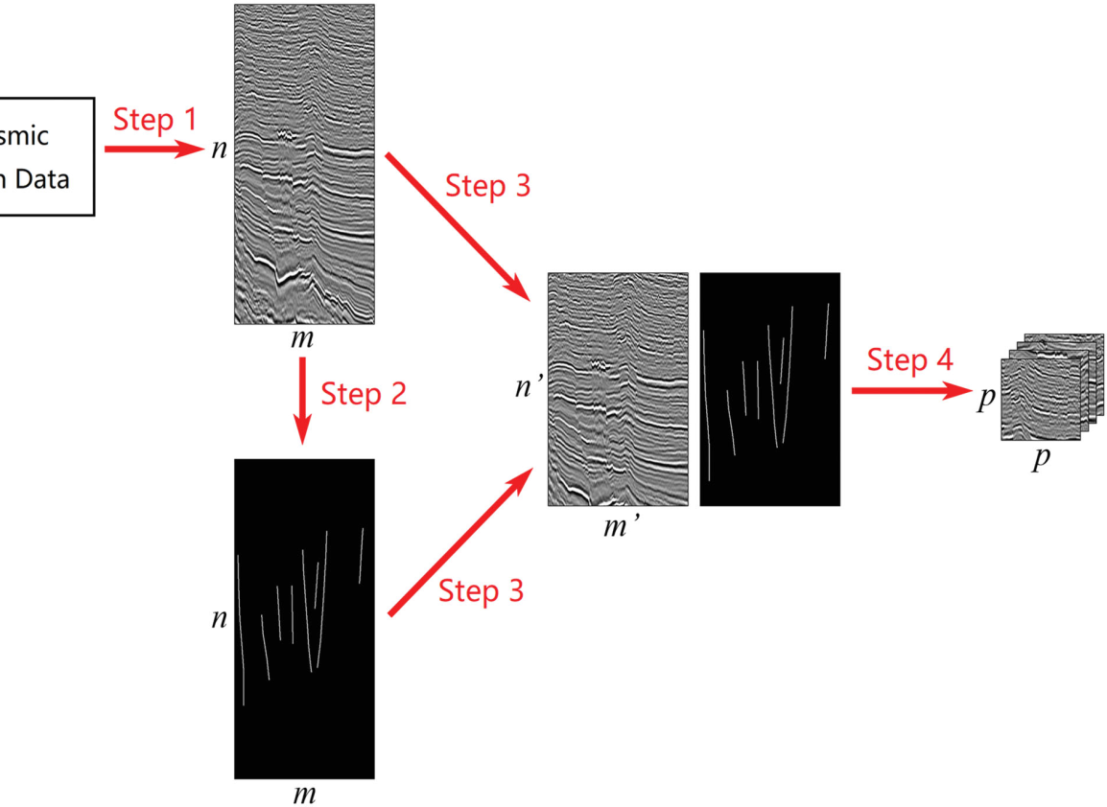
PREPROCESSING
Fault Labeling
Cropped the image to highlight Faults
Generating Samples

Slide 13
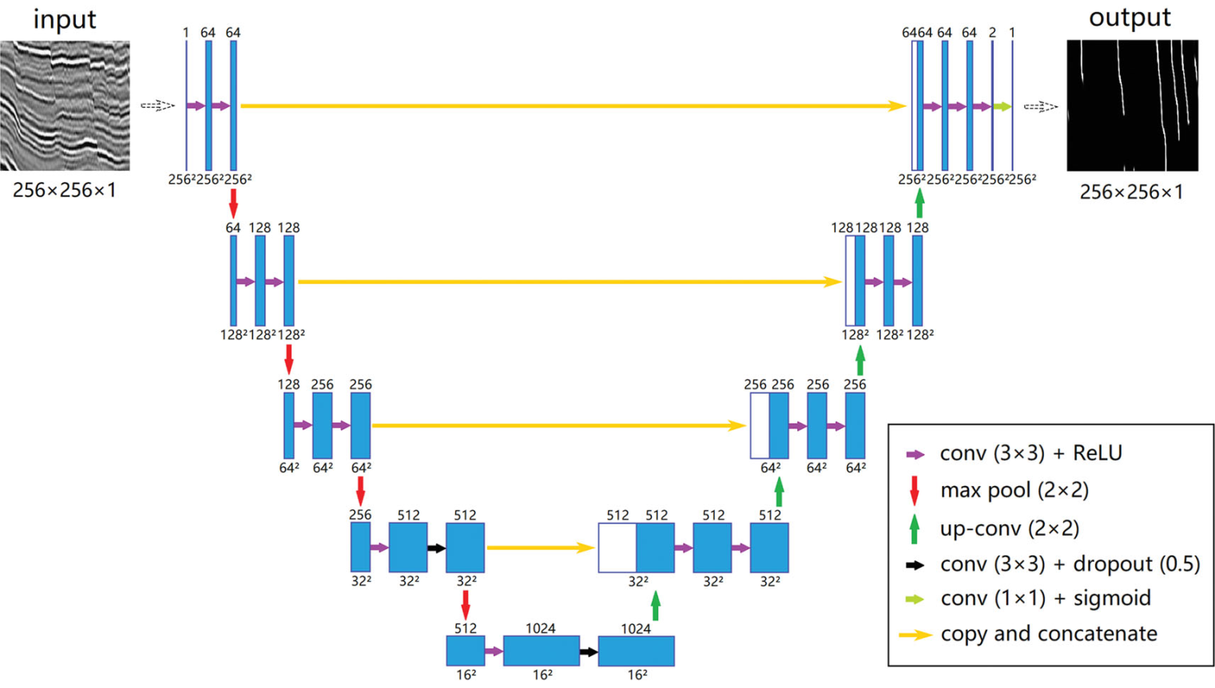
CNN Model Training

Slide 14
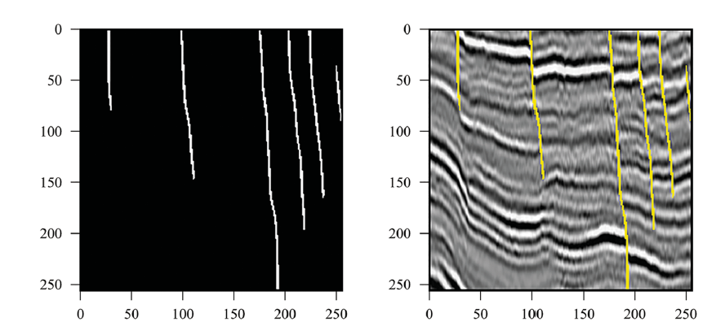
PREDICTION
The prediction part also has two steps:
CNN Model prediction
Postprocessing the model

Slide 15
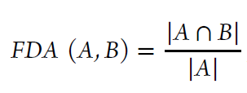
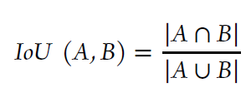
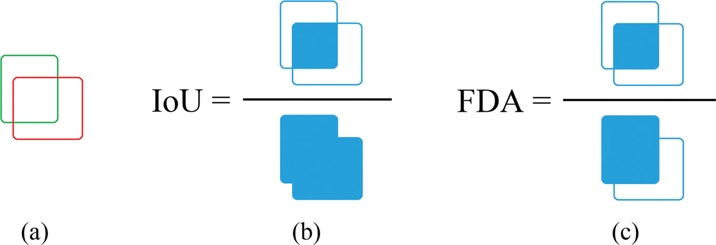
ACCURACY
Fault detection accuracy index
0 ≤ FDA (A, B) ≤ 1
0 ≤ IoU (A, B) ≤ 1

Slide 16
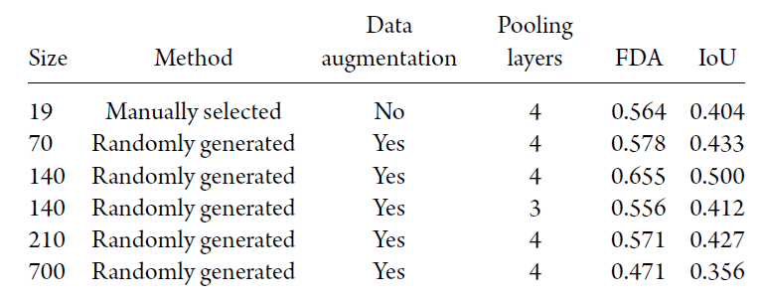
RESULTS

Slide 17
Conclusion
The proposed method has two obvious advantages,
High-cost effectiveness.
We can use real data as the training set without any concerns
About insufficient data.

Slide 18
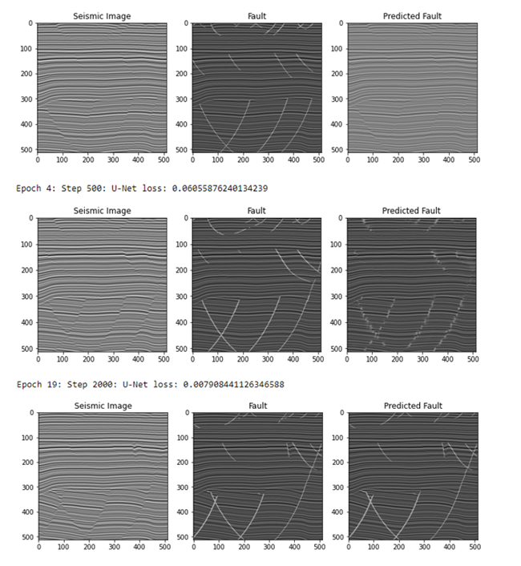
Observation/Graphs

Slide 19
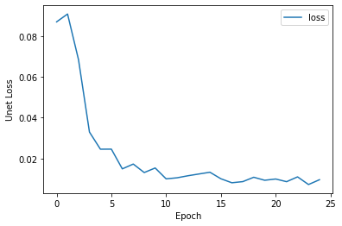
Observation/Graphs

